Slide 1
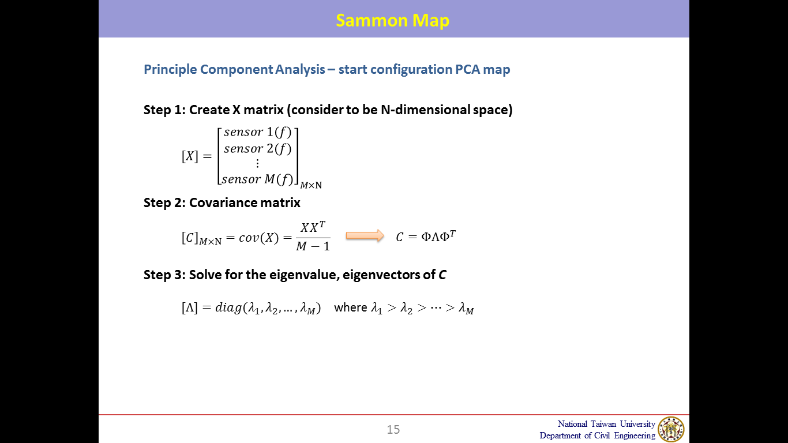

Methodologies for structural damage assessment
Level-2 Damage localization using Sammon map (centralized data analysis method)
Data points
Test cases
Sensors:
s1,s1~s9
10
National Taiwan University
Department of Civil Engineering
Notes:
Modified complex morlet wavelet 簡稱MCMW
是一種由複數指數乘以高斯窗組成的小波，這是他的時域及頻率域表示式
Sigma就是作為可調項與a同為縮放因子
而a=主頻率omega 0/分析頻率omega，
那因為主頻率又稱作central frequency，所以a又可改寫成fc/f

Slide 2
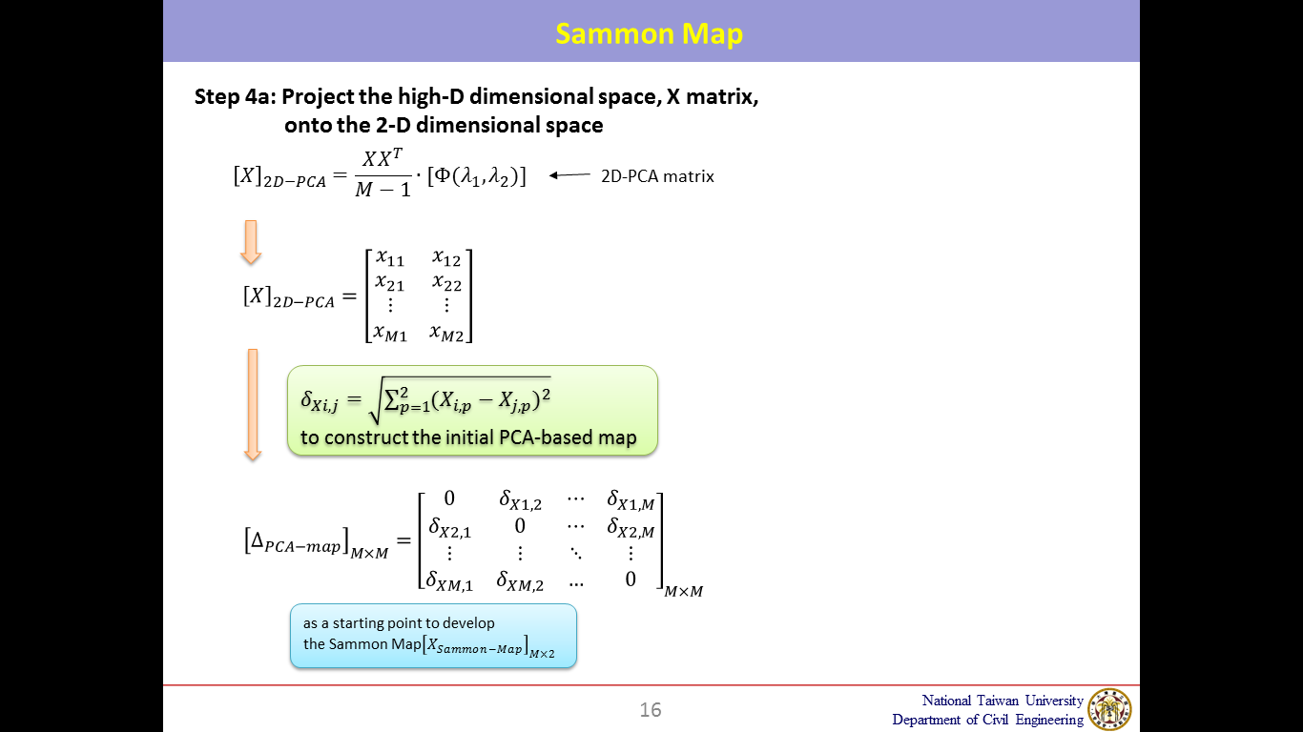
Methodologies for structural damage assessment
One data point in 2D-space
National Taiwan University
Department of Civil Engineering

Slide 3
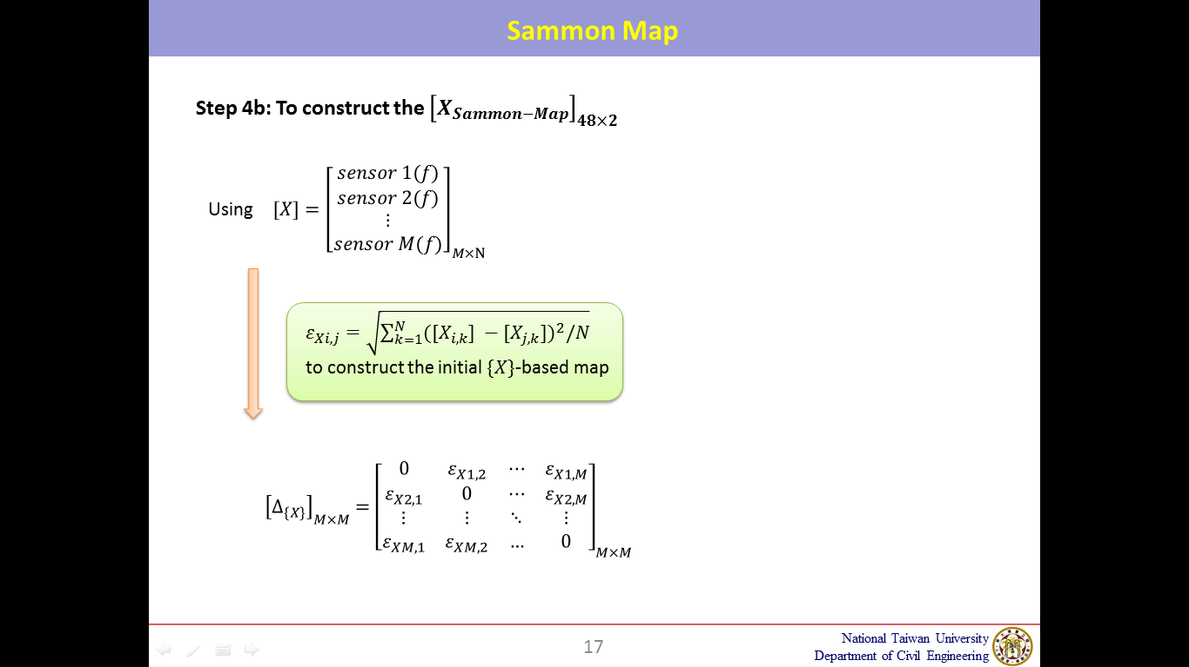
Methodologies for structural damage assessment
National Taiwan University
Department of Civil Engineering

Slide 4
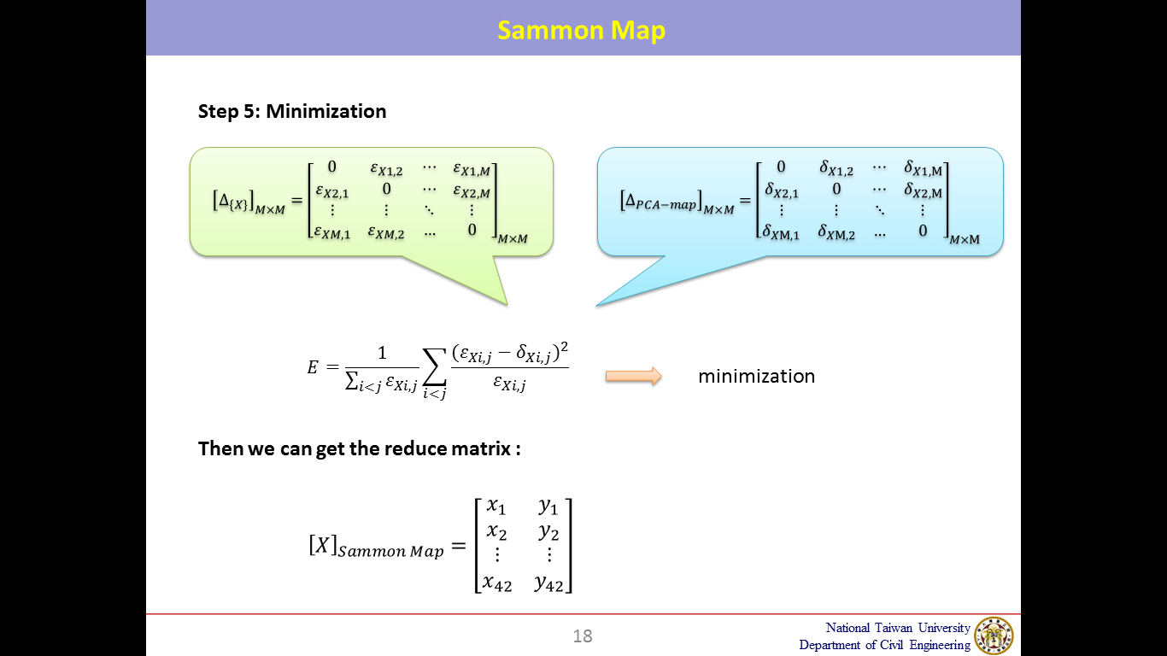
Methodologies for structural damage assessment
National Taiwan University
Department of Civil Engineering

